Slide 1
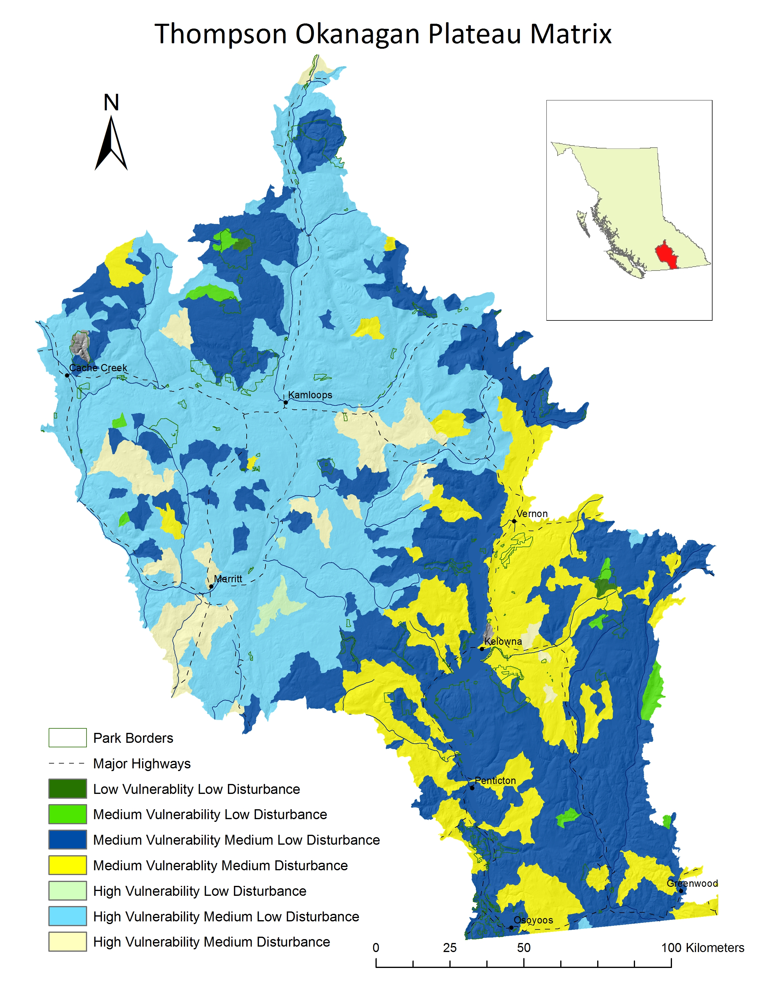
Thompson Okanagan Plateau Landscape Analysis
 | Disturbance (roadedness)
Vulnerability |  | low | med-low | med | high
 | low
 | med
 | high

